Slide 1
Machine Learning Final Project
Fathima Kamaludeen
Justin Landay
Vijayshri Rangasamy

Slide 2
Data
We chose to use the STL-10 dataset for our project which was made available by stanford (https://cs.stanford.edu/~acoates/stl10/) .
96x96 pixels color image
10 classes: airplane, bird, car, cat, deer, dog, horse, monkey, ship, truck.
Training : contains 500 labelled images per class
Testing : 800 images per class.

Slide 3
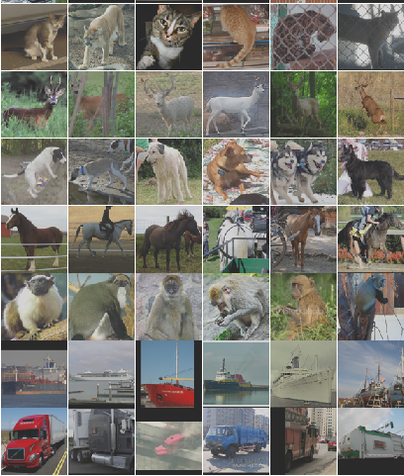
Sample Images

Slide 4
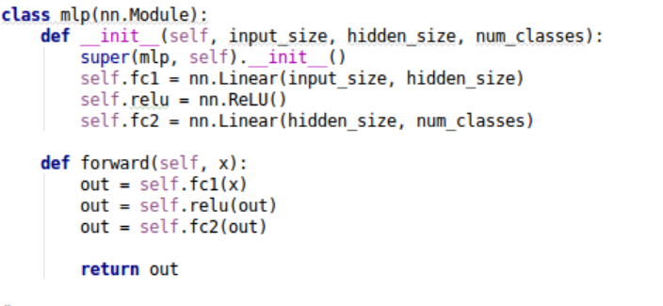
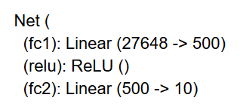
MultiLayer Perceptron Neural Network

Slide 5
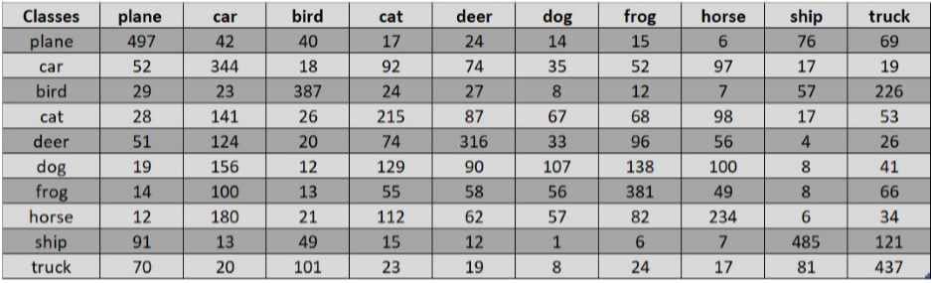
MLP Results
88% Training Accuracy and 43% Test Accuracy

Slide 6
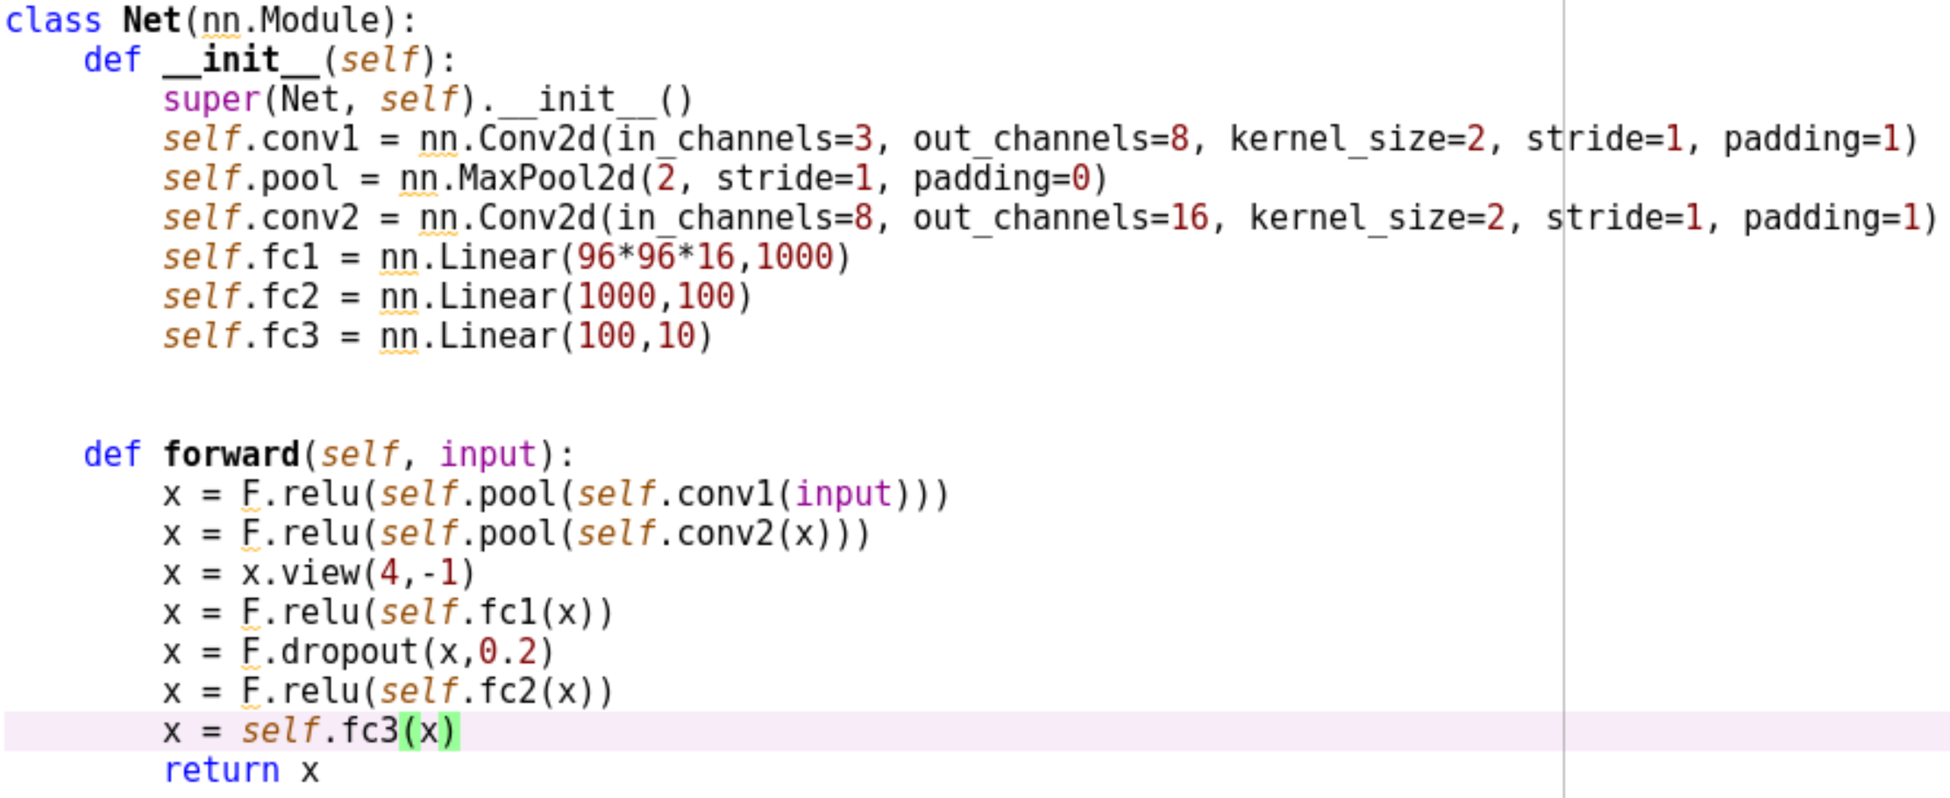
CNN 1 Architecture

Slide 7
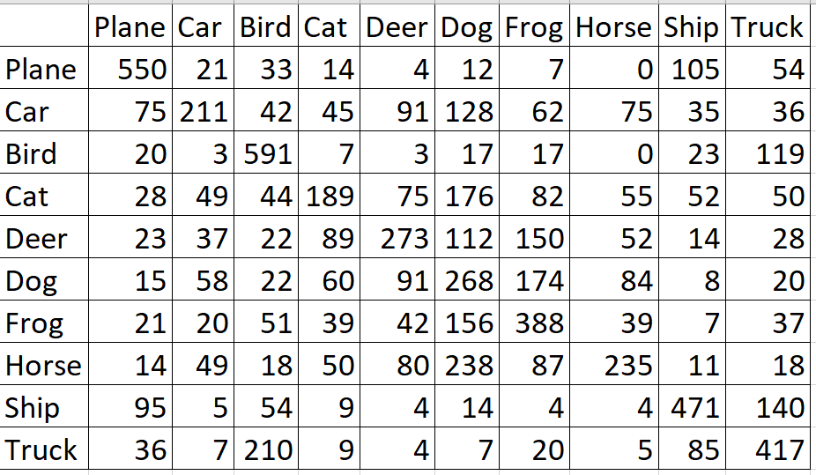
CNN 1 Results
99% Training Accuracy, 44% Test Accuracy

Slide 8
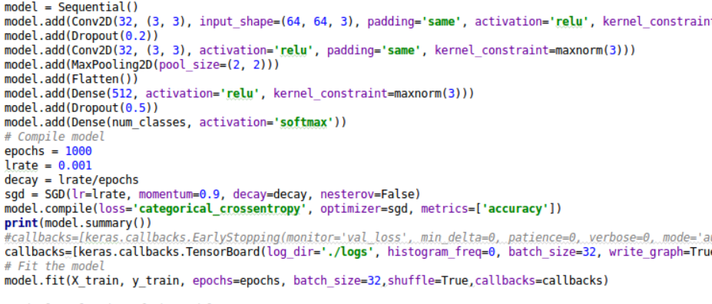
Keras - Convolution Neural Network

Slide 9
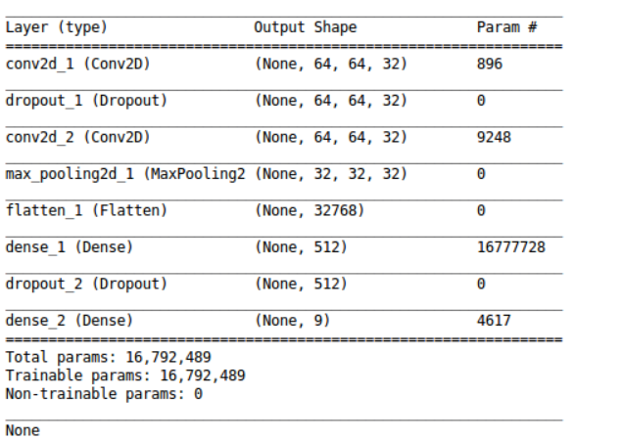
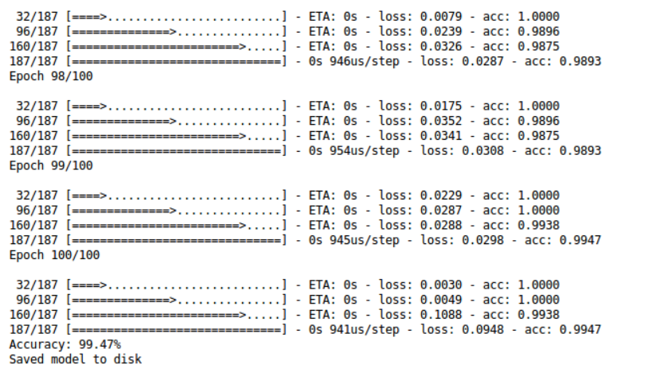
Keras Results
Architecture of the network Performance and Accuracy

Slide 10
Conclusions
Most of our conclusions aligned with our initial hypothesis that the CNN models would perform better during both the testing and training phases. We can see this by directly comparing either their accuracies or their confusion matrices.
Improvisation:
Addition of Batch normalization and Drop out at the same time.
Implement a few different optimizers with various learning weights and use K-Fold Cross Validation to find the optimal values.

